Slide 1
Category review: Chips
June 2020
Retail Analytics
Brand note: If client logo is not required, use alternate title page layout right click slide thumbnail > Layout > Title

Slide 2
Notes:
To view Privacy video explaining how important data privacy is to Quantium, please click here: https://www.youtube.com/watch?v=Zq1QDAkoRzU
or here Q:\Company Reference\Brand & Design\Brand videos\Q Privacy.mp4
At Quantium, we believe that data is the behavioural footprint of humanity and that it has to be treated with the utmost care and responsibility.
Histories, attitudes, indeed lives are stored within it in ways that aren’t always apparent – and that’s what makes its potential so powerful.
To work with it responsibly, sensitively, we set ourselves the highest data privacy protection and governance standards.
We have spent 17 years perfecting privacy-by-design and secure-by-design principles. Central to this is not holding any personally identifiable information about people –
we neither receive it, and put the necessary protections in place to be unable to decipher it.
Every aspect of handling data is safeguarded: from its de-identification, to its encryption – data security is paramount and of the highest grade.
We pride ourselves on gaining the trust of iconic organisations around the world through years of securely working with their data,
and in turn the trust that builds with their stakeholders.

Slide 3
Executive summary
01
Chips Category Review
The sales increase in the month of December before the Christmas (except the day itself. It is a good time to take advantage of this momentum with promotional offers. .
Kettle is the most popular brand followed by Smiths, Doritos and Pringles. So, they need to be in stock. Also 175 gram packets are the most sold.
Mainstream young singles/couples, retirees are the most common customers and also account for a great share of chips sale.
Older and Young Family segment have the highest average purchase units per unique customer.
02
Trial Store Analysis
One control store was selected for each trial store and the values of metrics were compared in trial and pre trial period.
The results for trial stores 77 and 88 during the trial period show a significant difference in at least two of the three trial months but this is not the case for trial store 86.

Slide 4
01
Category

Slide 5
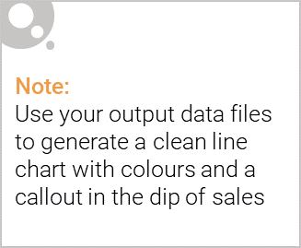
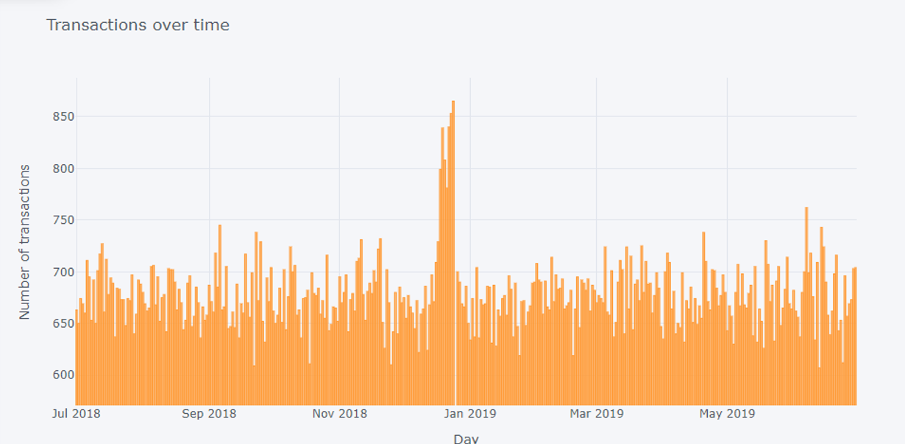
Sales Distribution
The sales have a sudden hike n the month of December before the Christmas (except the day itself). Whereas there is no sales on 25th.

Slide 6

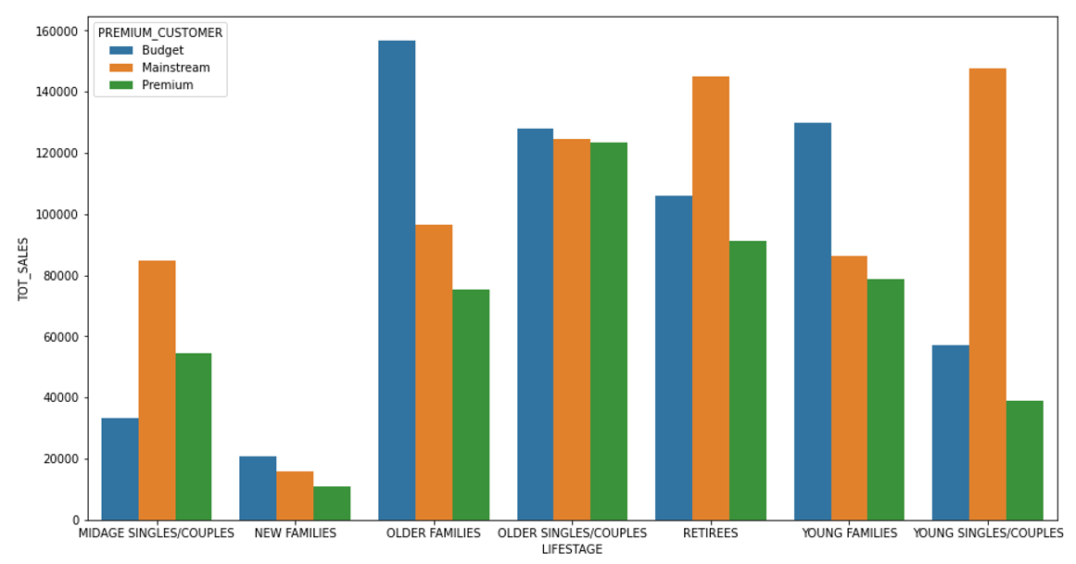
Older and Young Family segment have the highest average purchase units per unique customer.
Kettle is the most popular brand followed by Smiths, Doritos and Pringles.
Mainstream young singles/couples, retirees are the most common customers and also account for a great share of chips sale.
Budget older families have the maximum contribution to sales.
Mainstream young singles/couples and mid-age single/couples pay more per packet than any other group.

Slide 7
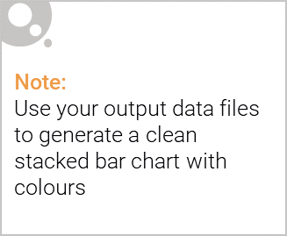
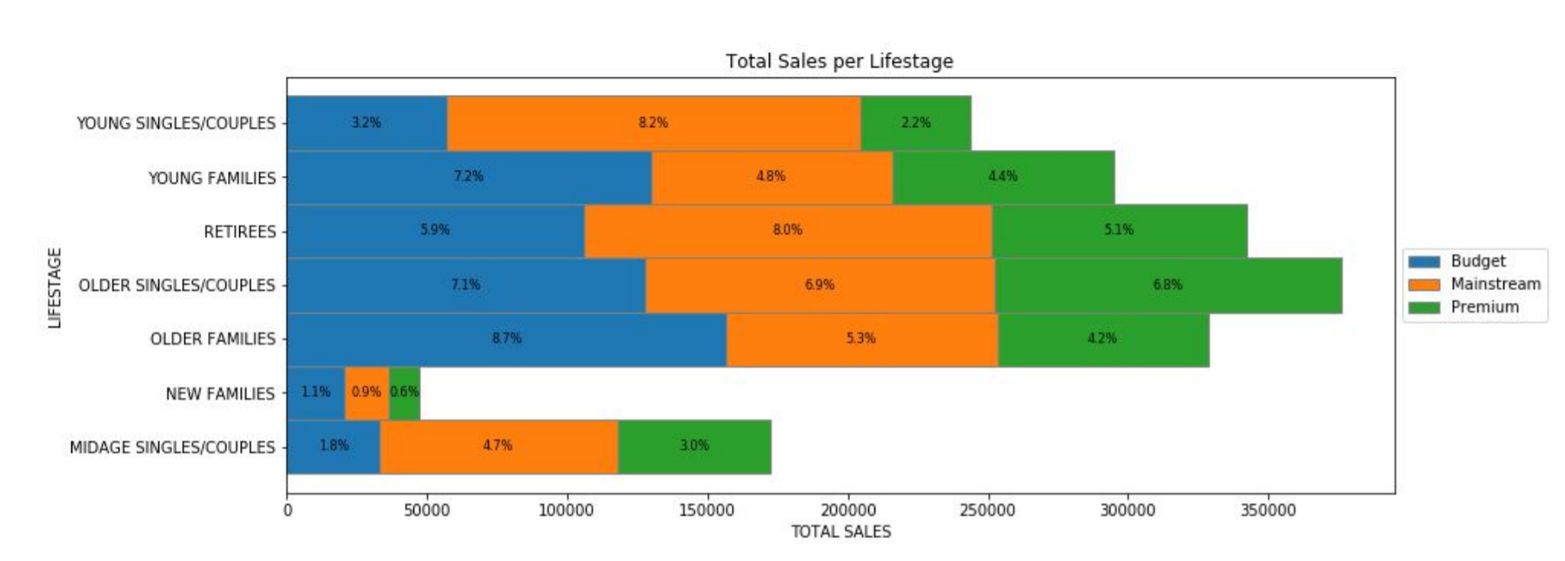
Editable (delete this)
Sales mainly came from Budget - older families, Mainstream - young singles/couples, and Mainstream - retirees. In total, older customers buy more than younger customers. Non-premium customers buy more than premium customers.

Slide 8
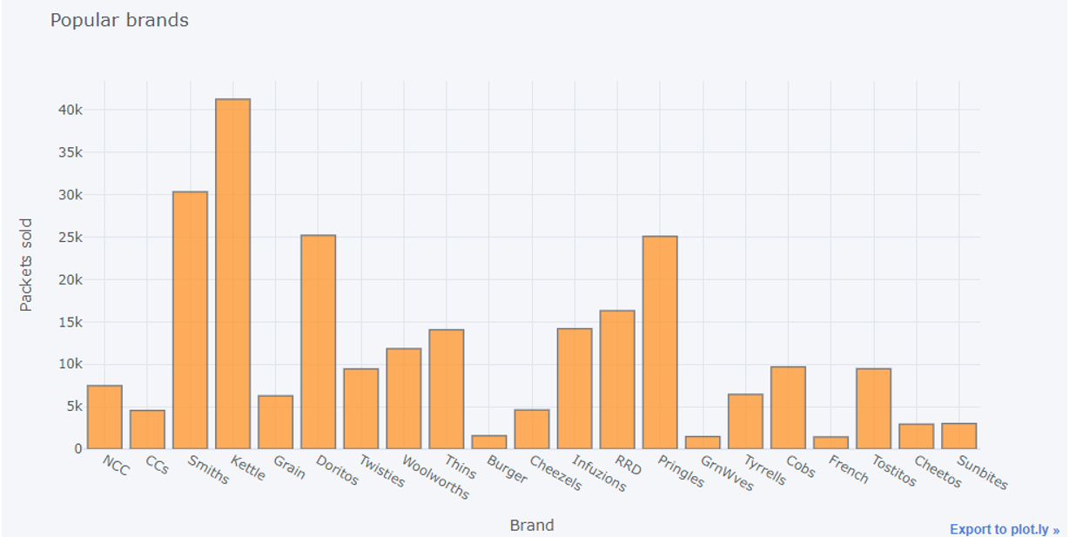
Popular Brands

Slide 9
02
Trial store performance

Slide 10
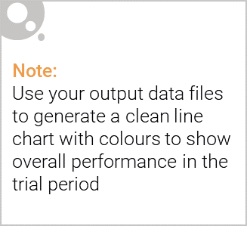
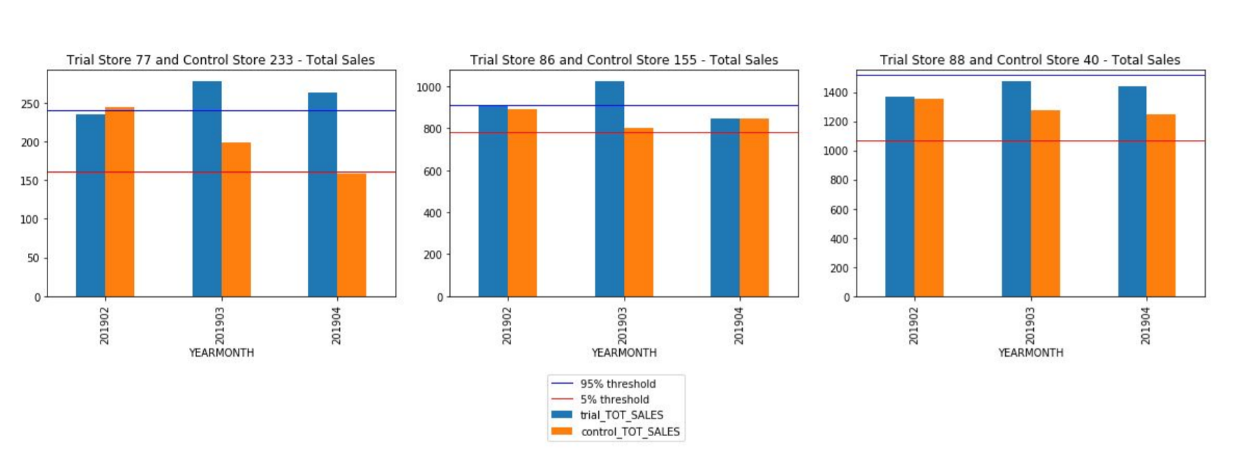
Explanation of the control store vs other stores:
Trial store 77 second and third month, and trial store 86 second month had significantly higher sales than Control store. Whereas trial store 88 sales increase is insignificant.

Slide 11
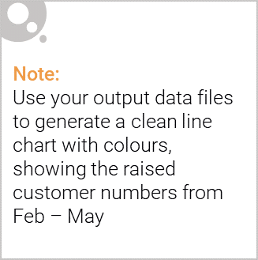
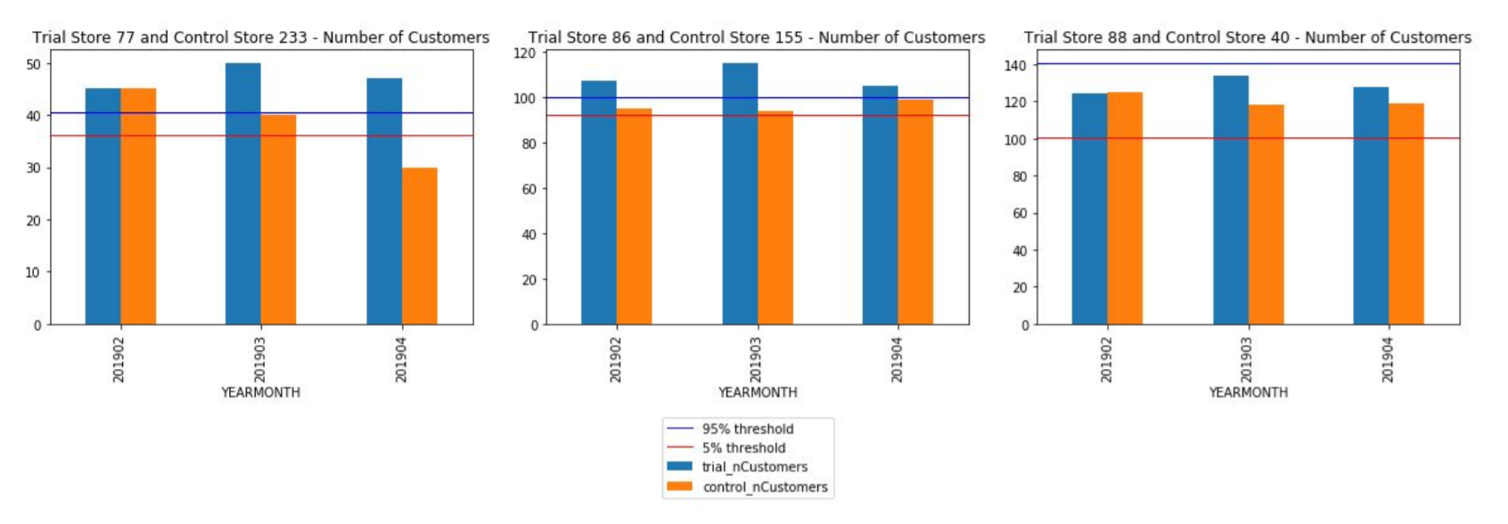
Trial store 77 and 86 had significant increase in number of customers during Trial period compared to Control stores, proving an effective trial run. Whereas trial store 88 customers increase is insignificant.

Slide 12
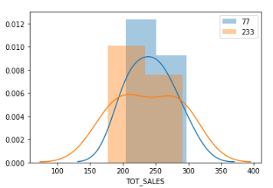
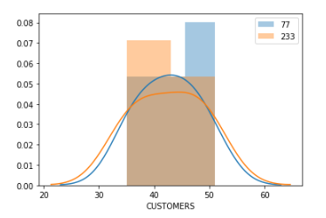
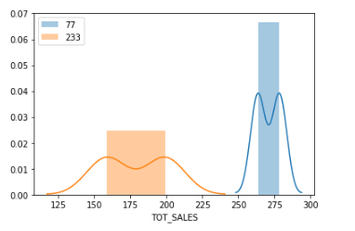
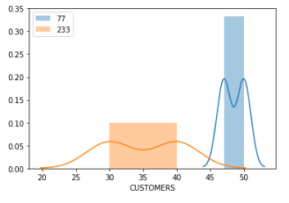
Trial store 77 vs Store 233

Slide 13
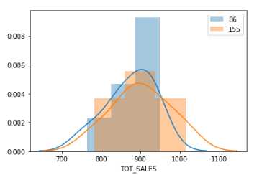
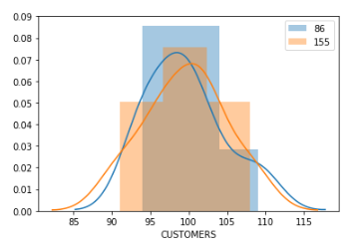
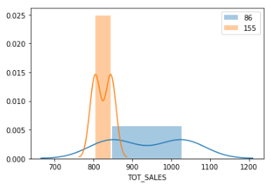
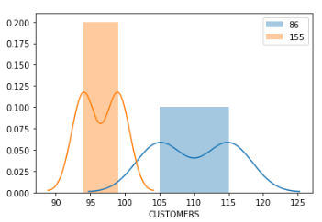
Trial store 86 vs Store 155

Slide 14
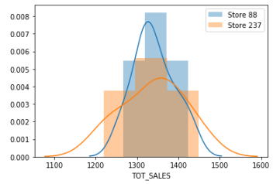
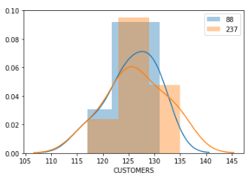
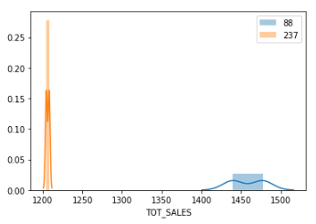
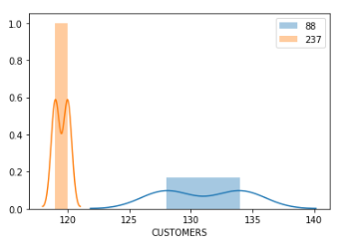
Trial store 88 vs Store 237

